Slide 1
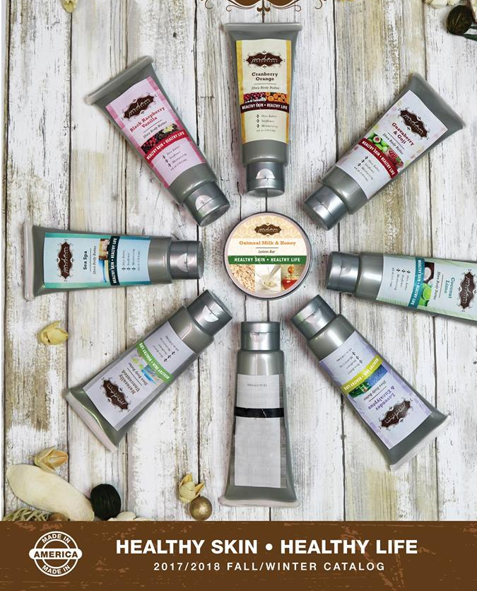
Jordan Essentials EVENT Guide

Slide 2
Finding an Event
Internet search
Face Book
Craft shows
Festivals
Organizations
Local Area
Chamber of Commerce
Community Organizations
Fair ground
Expo Center
Churches
Schools
Other vendors

Slide 3
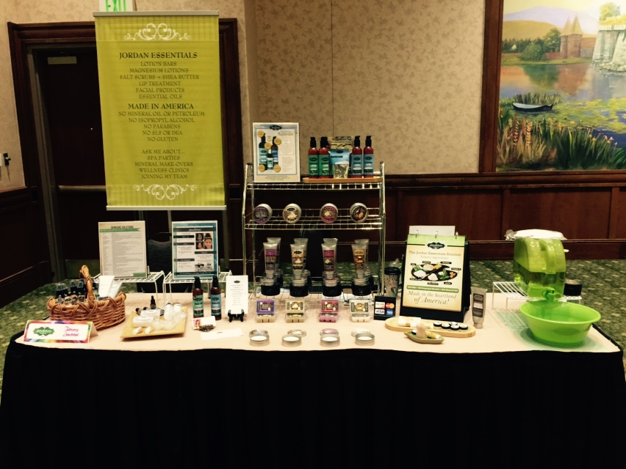
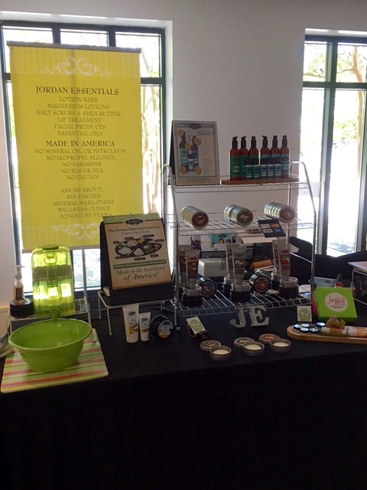

Slide 4
Set Up for Salt Scrubs

Slide 5
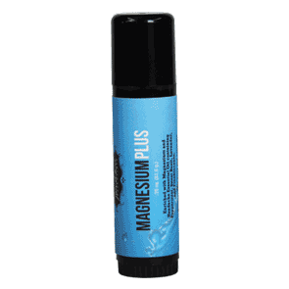
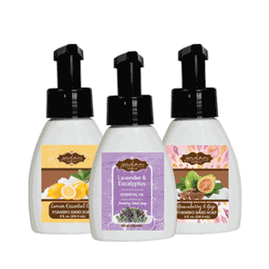
Best Sellers

Slide 6
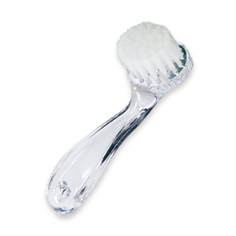
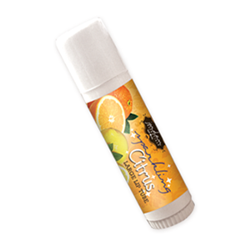
Lip Treatment
Add-Ons
Deodorant
Charcoal
Mask

Slide 7
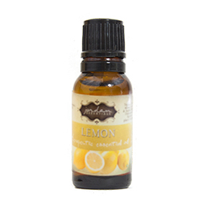
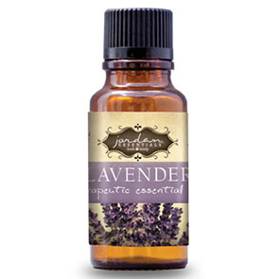
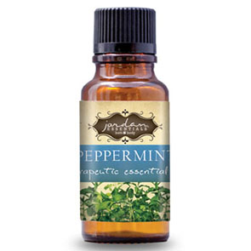
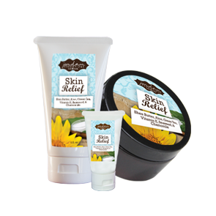
Essential Oils
Wellness
Skin Relief

Slide 8
Demo Samples
Only put out what you have to sell.
Interested in something else, offer a party
Unscented Shea Butter
Unscented Salt Scrub
Full Size Lotion Bars in the fragrances you’re selling
Lip treatment (large lip tubes)
Magnesium (both peppermint & unscented)
Magnesium Stick
If doing Health & Wellness focus – bring Skin Relief and Essential Oils

Slide 9
Inventory
Inventory depends on the show
How many years it has been in existence
How many attendees in the past
How many days does the event run
Rule #1:
NEVER take more than you can afford to bring

Slide 10
We use only 3 fragrances – no more as this can delay customers in making their decision or overwhelmed and walk away without making a purchase.
Sell Systems: Basic + Foaming Soap.
Lotion Bars: When selling Lotion Bars, remind them to buy for gifts.
Lip treatments: Sample with toothpicks
Magnesium Products: Best seller. Use signage to help sell the product! Combine Lotion and Stick for additional savings.
Skin Relief, Charcoal Products & Essential Oils are great for health & wellness
Special Basket
Discontinued, Monthly Specials and Hostess Items
Spend $50 get anything in my basket for $5

Slide 11
$200 Inventory Suggestion
4 Lotion Bars
2 Large lip
2 Unscented Magnesium
2 Mini Unscented Magnesium
2 Peppermint Magnesium
2 Mini Peppermint Magnesium
3 Magnesium Plus Sticks

Slide 12
$350 Inventory Suggestion
3 Basic Systems
3 Foaming Hand Soap
4 Lotion Bars
2 Large lip
3 Unscented Magnesium
3 Peppermint Magnesium
5 Magnesium Plus Sticks

Slide 13
$300 Inventory Suggestion + Essential Oils
3 Lavender Lotion Bars
3 Unscented Magnesium
3 Peppermint Magnesium
5 Magnesium Plus Sticks
2 Skin Relief Tubs
2 Charcoal Soaps
2 Deodorants
Essential Oils
Lavender
Peppermint
Lemon

Slide 14
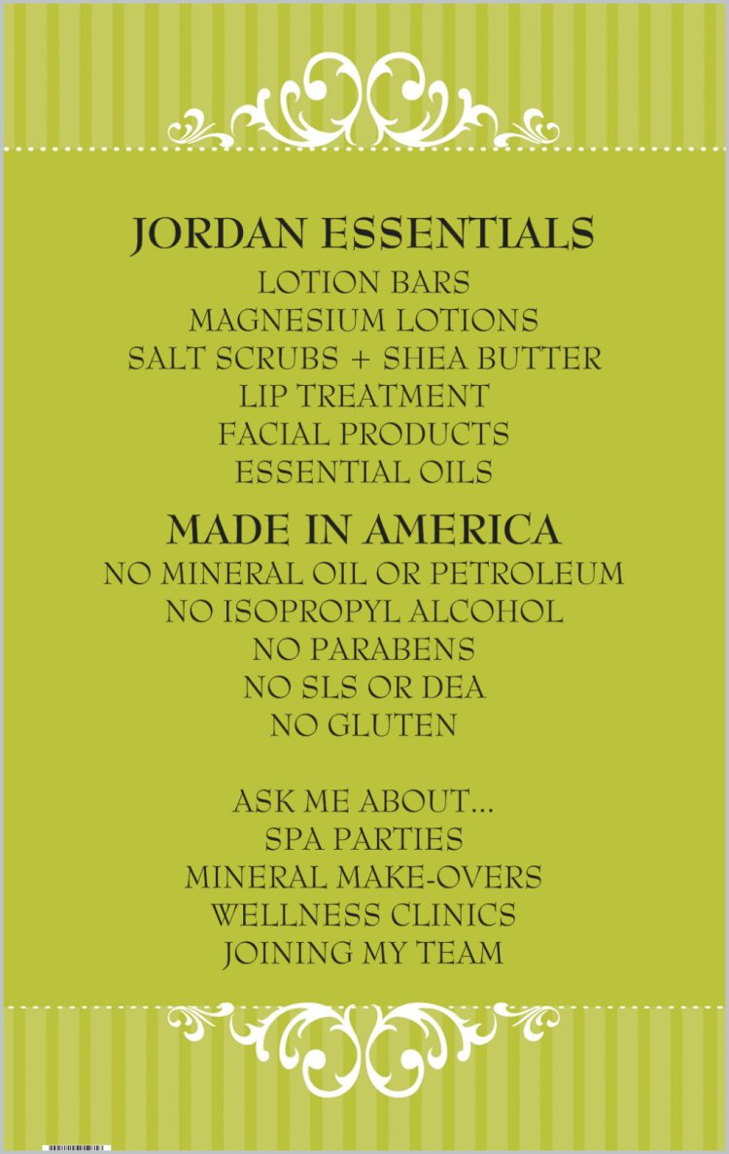
Signs

Slide 15
Business Center

Slide 16
Information

Slide 17
Show Rules for Sharing the Space and Sales
I prefer NOT to do craft/trade shows by myself.
Encourages you to keep selling and not get lazy
Who you talk to is your customer and lead.
Both Consultants bring the exact same product.
Do not label any product until you sell it.
Both bring the same amount of seed money to start.
Take your own credit card orders
End of the show: Add money and credit cards. Split the money and split any remaining product equally.
Prize Drawing – Lotion bar is all you need
Specials Basket

Slide 18
Credit Cards
Potential Larger Sales
Suggest a Square
App for phone
Fee of 2.75%
Is worth it to get the sale

Slide 19
What Do You Want from an Event?
Get people to come to the booth
Invite them
3 Options
Make a Purchase
Book a Show for Free Product
Information about becoming a Rep
Leads from Prize Slips
Follow up

